Slide 1
Guess game and probability applications
Applied probability and statistics’ project
Made by: Omar El-Sayed Abo Al-Fotoh ID: 5317216
Amr Mostafa Alnagar ID: 5317235
Mohammed Adel Salah ID: 5327307
Abdelrahman Rafaat Kharboush ID: 5317170
Menna Mohammed Ismail ID: 5317383
Under the supervision of Dr. Wessam M.Salama

Slide 2
Content
1- Introduction
2- The concept of the guess game
3- Code illustration and running it
4- Probability and coding
5- Real-life applications the apply the concept of the guess game

Slide 3
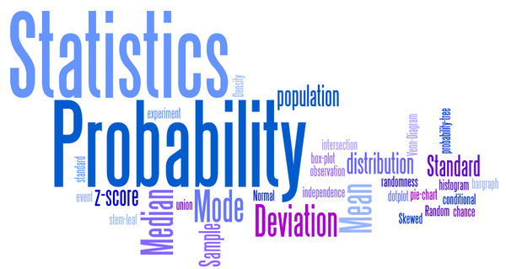
Introduction

Slide 4
What is “Applied probability”?
Applied probability is the application of probability theory to statistical problems and other scientific and engineering domains.
Applied probabilists are particularly concerned with the application of stochastic processes, and probability more generally, to the natural, applied and social sciences, including biology, physics (including astronomy), chemistry, medicine, computer science and information technology, and economics.

Slide 5
Today, we’re going discuss the “Guess game”! It applies the definition of applied probability and many applications work with the concept of it.

Slide 6

The concept of the guess game

Slide 7
What is the “Guess game”?
This guess game is an application written by java programming language. You can write it in any language you want, but our application is written by java language.
From the name of, the whole behind the guess game is trying to predict the right choice.
In our application, we used a very simple concept using just integer numbers.

Slide 8
It consists of three different levels. Each one does a different job, which will be illustrated later in the presentation.
The user will be given 5 chances to predict the right answer.
If he didn’t predict it right, the program will show the right answer and close it.

Slide 9
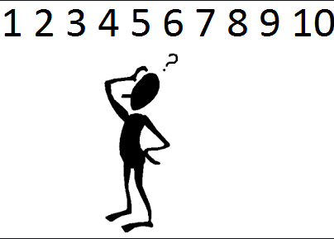
The aim of the game
The application itself aims to give the user the knowledge about probability and how it gets applied in every level of the game.
Also, it helps to show the world of software and how it can be connected with applied probability. We’ll talk about this later in the presentation.

Slide 10
Code illustration and running it
Let’s go to our compiler to see the code, see how it works and run to check the game process.

Slide 11
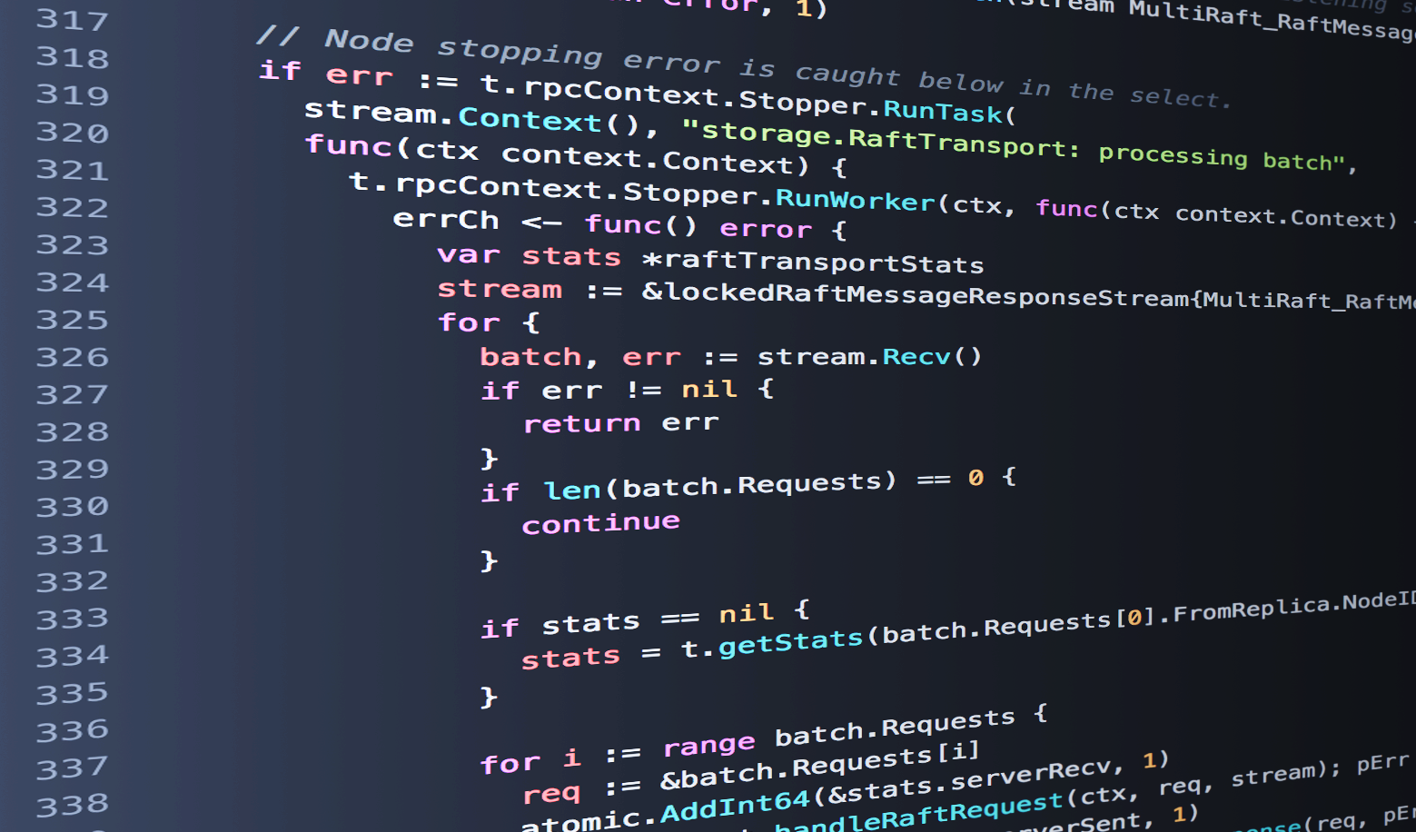
Probability and coding

Slide 12
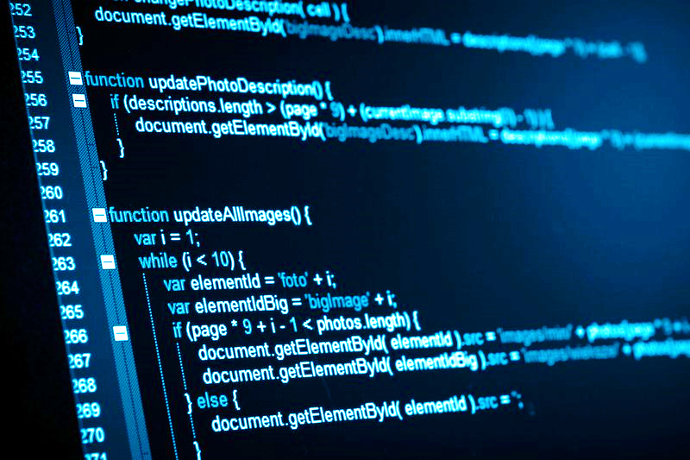
Is coding related to probability?
Coding is a simply some instructions put together in a particular order to create a particular program. There are many styles of coding, as you can use many different programming languages.
But the question here is that does it needs the concept of probability while programming an application or building a website?

Slide 13
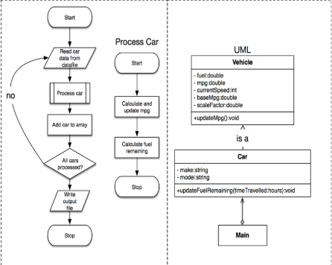
Well, the answer is yes!
Imagine you are a programmer, and you were told to create an application or design a website. Do you just start coding without designing?
Well, designing anything in programming is an application of applied probability!
Predicting the outcome of an input from the user, getting the probability of wrong inputs and correct inputs.
All of this, and more, prove the point that coding and probability are related together.

Slide 14
Real-life applications the apply the concept of the guess game

Slide 15
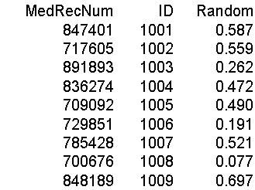
1- Random ID generator

Slide 16

2- Random Restaurant order and number generator

Slide 17
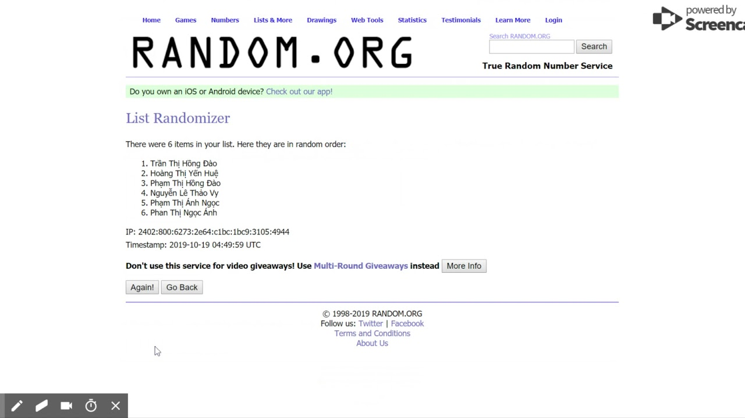
3- Random name selector from the computer

Slide 18
And that’s a wrap! Thank u all for listening! Hope u enjoyed our content.

